Slide 1

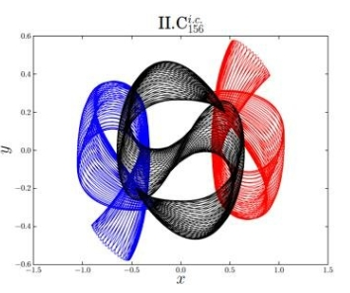
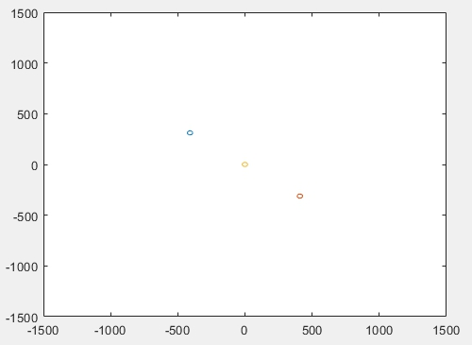

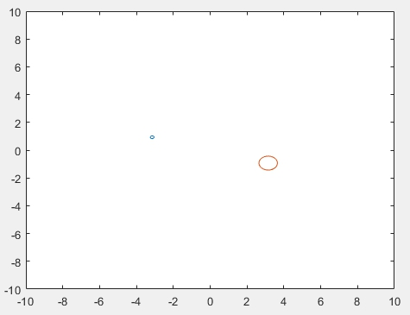
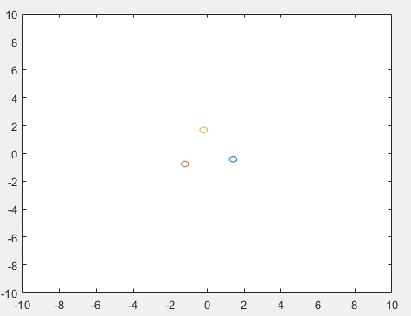
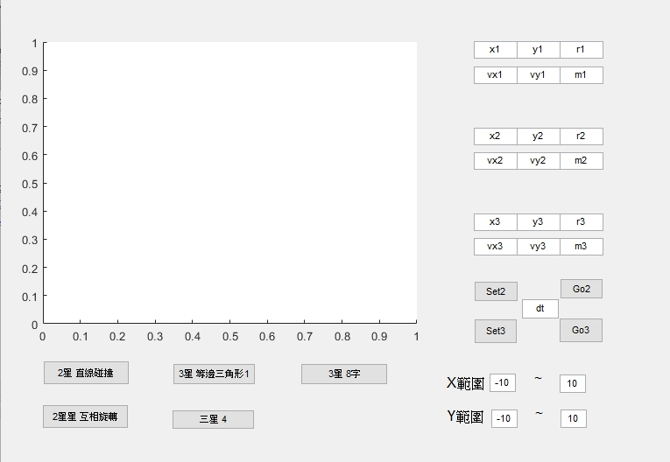
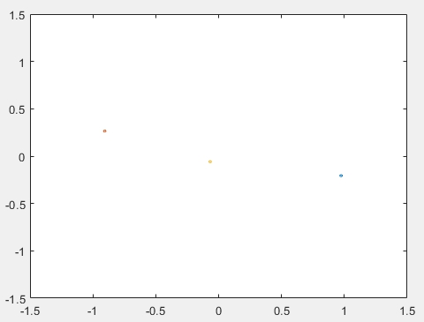
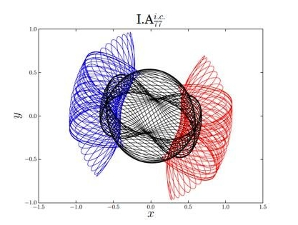
2018 Experimental Physics MATLAB Project
Three- Body Problem in 2D
106022101 李巧柔 , 106022103 劉弘祥
▲ Abstract
The three-body problem is the problem of taking the initial positions and velocities of three point masses and solving for their subsequent motion as dictated by Newton’s laws of motion and of universal gravitation.
There is no closed-form solution for all sets of initial conditions, and numerical methods are generally required.
▲ Matlab Simulation
Three-star system
Binary star
Two stars that revolve around a common center star.
Control Panel
Two-star system
Binary star
Two stars run elliptic around a center.
Three-star system
Equilateral triangle
Relative to three points, center is immobile.
Three-star system
Figure-eight shape
Discovered by physicist Cris Moore at the Santa Fe Insitute in 1993.
▲ Reference
https://blog.csdn.net/ctyqy2015301200079/article/details/83177232
https://wenku.baidu.com/view/4f6c960b844769eae009edc2.html
淺談三體問題—東南大學: http://hpc.seu.edu.cn/dong/class/2014-Ganqingyu.pdf
https://phys.org/news/2017-10-scientists-periodic-orbits-famous-three-body.html

